Slide 1
A PhD at the EUI
Start the intellectual adventure of a lifetime

Slide 2
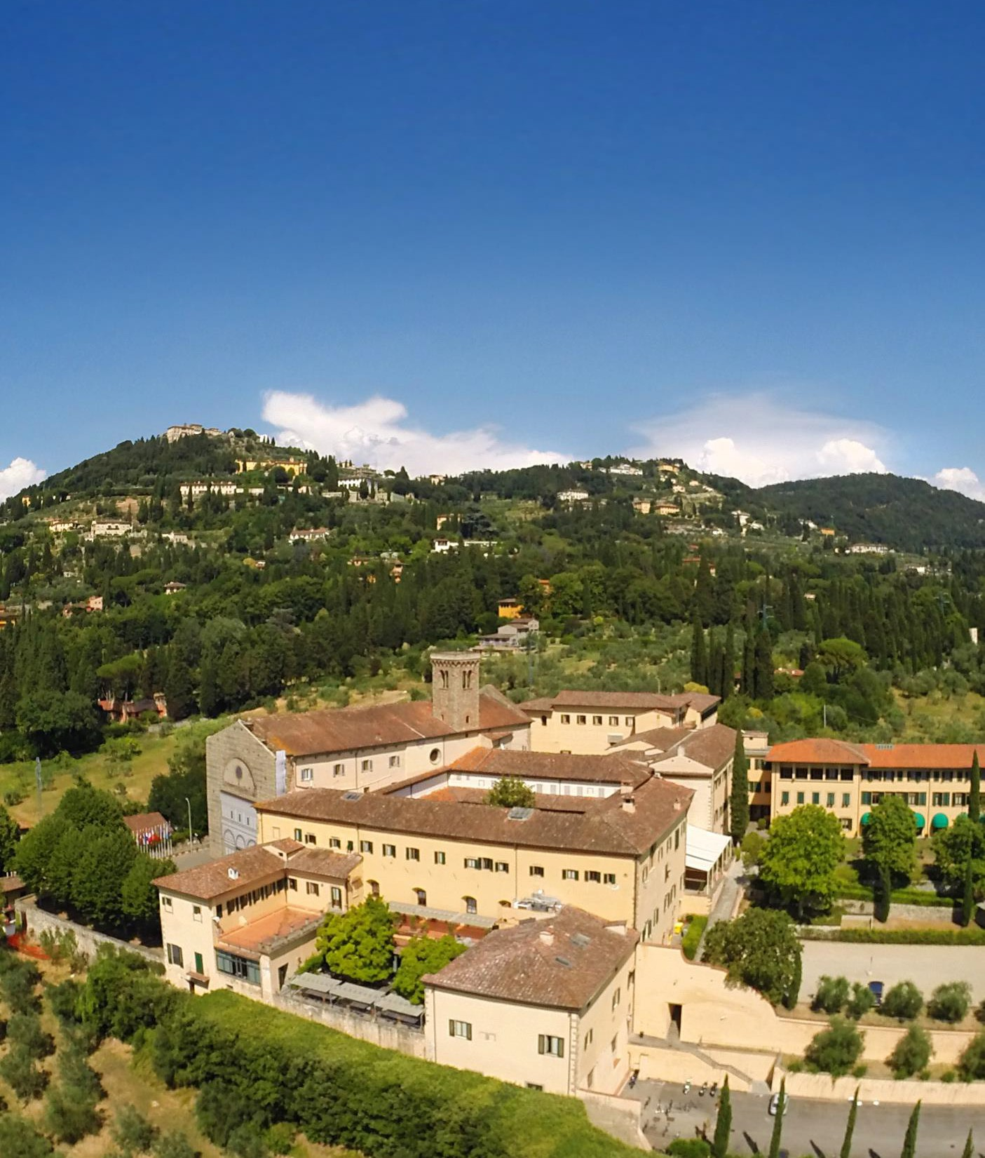
The EUI
Situated in the hills above Florence, Italy, the EUI Europe’s postgraduate and postdoctoral research university dedicated to the social sciences and humanities.
Established in 1972 by the European Union’s founding member states, the EUI is an intergovernmental organisation providing advanced academic training and cutting-edge research opportunities.
The Institute is composed of four departments:
Economics
History
Law
Political and Social Sciences
and it is home to the Florence School of Transnational Governance, the Robert Schuman Centre for Advanced Studies, and the Historical Archives of the European Union.
1000+
Scholars
100+
Countries
370
Academic and teaching staff
344 Administrative staff
Notes:
The EUI is currently funded by its 24 Contracting States.

Slide 3
Our academic community
Join our culturally diverse academic community – study alongside 1000+ scholars from 100+ countries
590+
Full-time researchers (PhD, LLM and MRes)
60+
Visiting Students
150+
Full- and part-time professors
100+
STG Master Students
120+
Full-time fellows
(post-doctoral and senior)

Slide 4
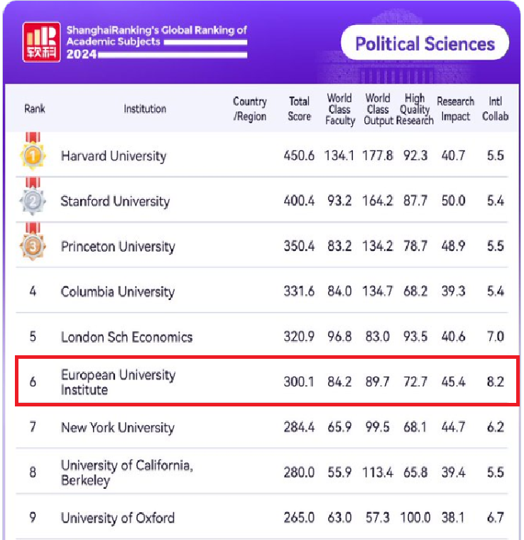
Internationally Recognised

Slide 5

Our educational offer
PhD programmes (fully-funded)
Master of Arts in Transnational Governance
Master of Research in Economics
Fellowship opportunities
Executive Education
Global Executive Master
Notes:
The EUI offers doctoral and postdoctoral research in Economics, History, Law, Political and Social Sciences.

Slide 6




Four-year PhD Programmes
Up to 130 fully-funded scholarships available every year in:
Political and Social Sciences
Economics
History
Law

Slide 7





Structured PhD Programme
Laying the foundations for your doctoral work.
Structured programme of taught courses and/or seminars defined by each department.
Each department defines content of activities, seminars, workshops, and research missions.
Each department defines content of activities, seminars, workshops, research missions and/or exchanges.
Completion of the thesis and job market activities.
Thesis defense.
Award of the Doctorate.
Submission of
thesis outline (requirements vary across departments)
Delivery of 1/4 of thesis
Delivery of 2/3 of thesis
Submit full draft of thesis
Interdepartmental courses,
academic and professional development

Slide 8
Structured PhD Programme
Close supervision with regular monitoring to assess teaching and quality of supervision
PhD Programme governed by
- Academic rules and regulations
- Code of Supervision
- Code of Ethics in Academic Research
- Data Protection Practice in Research

Slide 9
Academic and Professional development
Wide range of courses, workshops, services and activities designed to support academic and professional development:
  Academic writing
  Introduction to teaching in higher education
Teaching placements and traineeships
Exchange programmes
Research missions
Field work
First generation initiative

Slide 10
Employment of EUI Alumni
PhD Political and Social Sciences

Slide 11
Employment of EUI Alumni
PhD Economics

Slide 12
Employment of EUI Alumni
PhD History

Slide 13
Employment of EUI Alumni
PhD Law

Slide 14
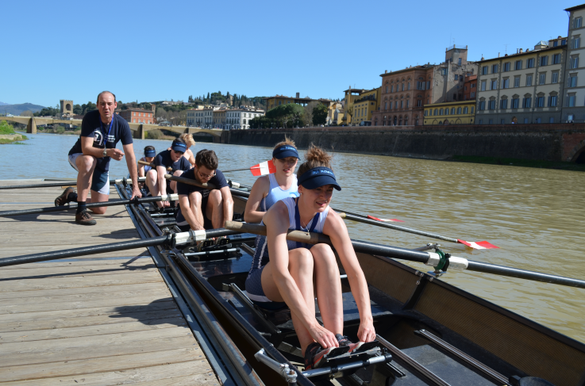


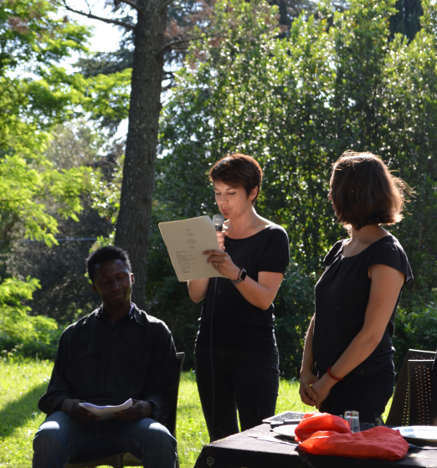

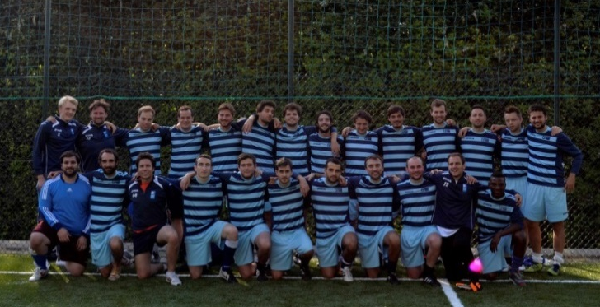
More than just writing a thesis

Slide 15
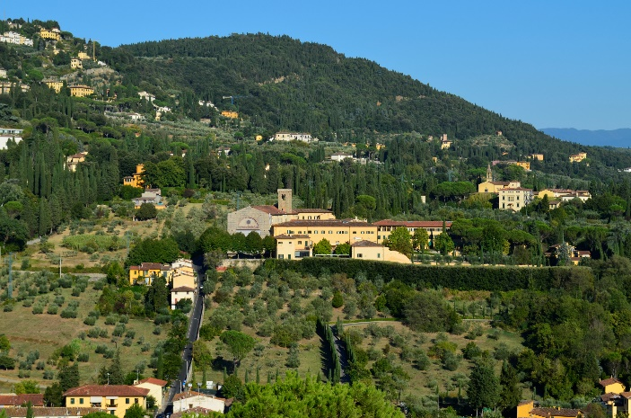
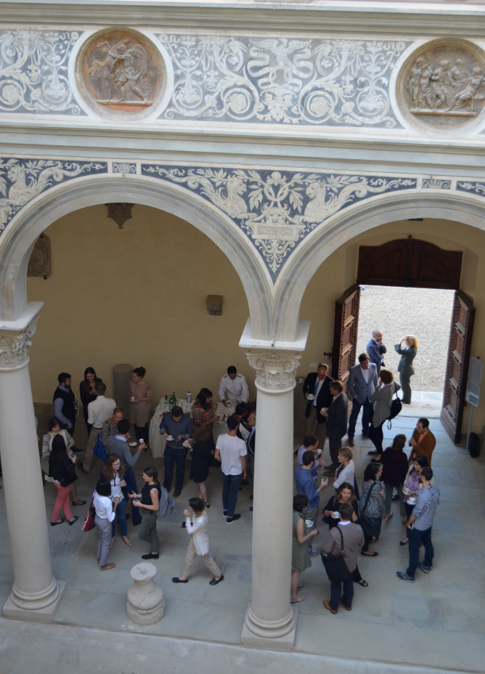
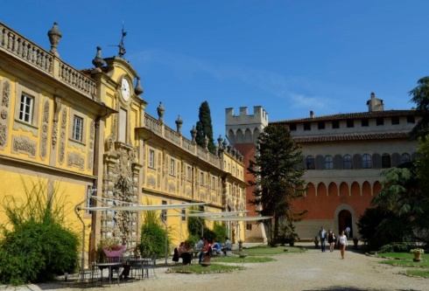
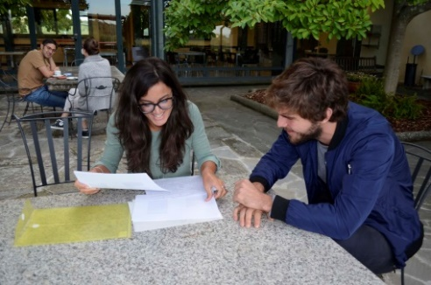
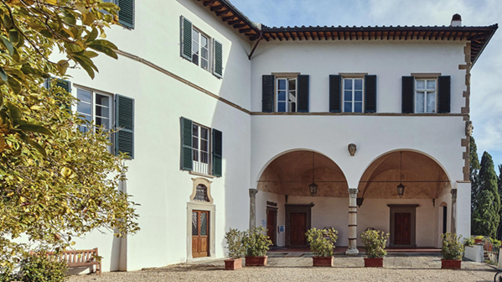
Our campus
Situated in the Tuscan hills, between Fiesole and Florence

Slide 16
Application and Selection
1 November
Mid-January
February /
March
Mid-Late March
Early April
Opening of application
process
Deadline for applications
Processing of applications / preselection
Interviews
Decisions about admissions
End of
August
1 September
Funding Eligibility criteria: Set by funding authorities
Selection criteria (EUI):
Academic record
Quality of the research proposal
Potential supervision
Language abilities
Registration
Introductions and start of the academic year

Slide 17










CIVICA members
A ten-member alliance founded on long-standing ties, reflecting the diversity of European higher education
Italy
Austria
Intergovernmental
Germany
Spain
teaching languages
international students
Romania
France
Poland
Sweden
United Kingdom

Slide 18






CIVICA at a glance
10
72,000
13,000
universities
students &
doctoral researchers
academic staff
4
168
thematic priorities
research institutes

Slide 19
Contact
Admissions office
Email: applyres@eui.eu
www.eui.eu/phd

Slide 20

Thank you!

